Slide 1
COURSE PROJECT
A Survey Hand Detection and Finger Pose Estimation
Applications in Human-Machine Communication
Students:
- Dương Thị An
- Phan Đình Anh Quân
- Phạm Gia Thông
- Hoàng Đức Nhật Minh
HCMUS UNIVERSITY OF SCIENCE

Slide 2
CONTENT
Motivation
Problem Statement
Related Work

Slide 3
MOTIVATION

Slide 4
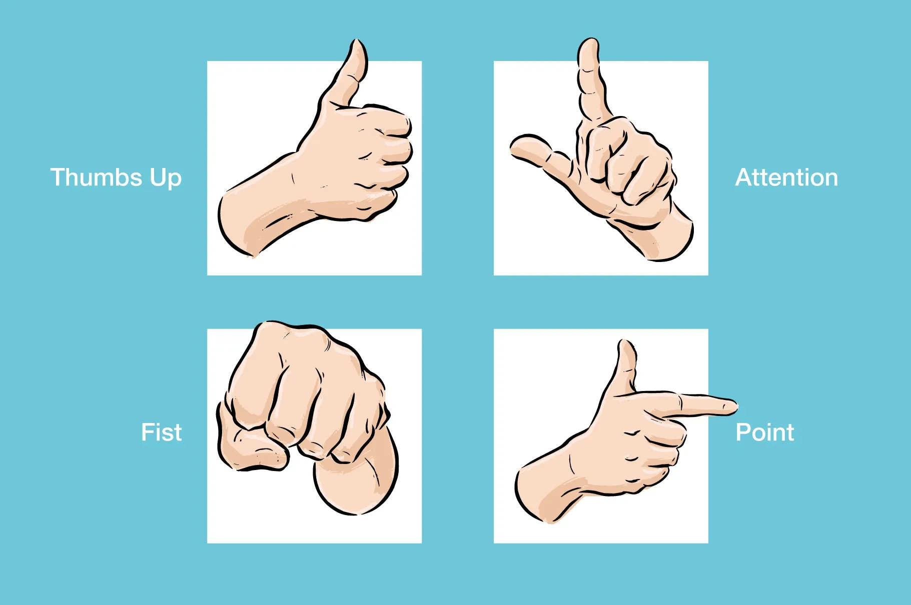
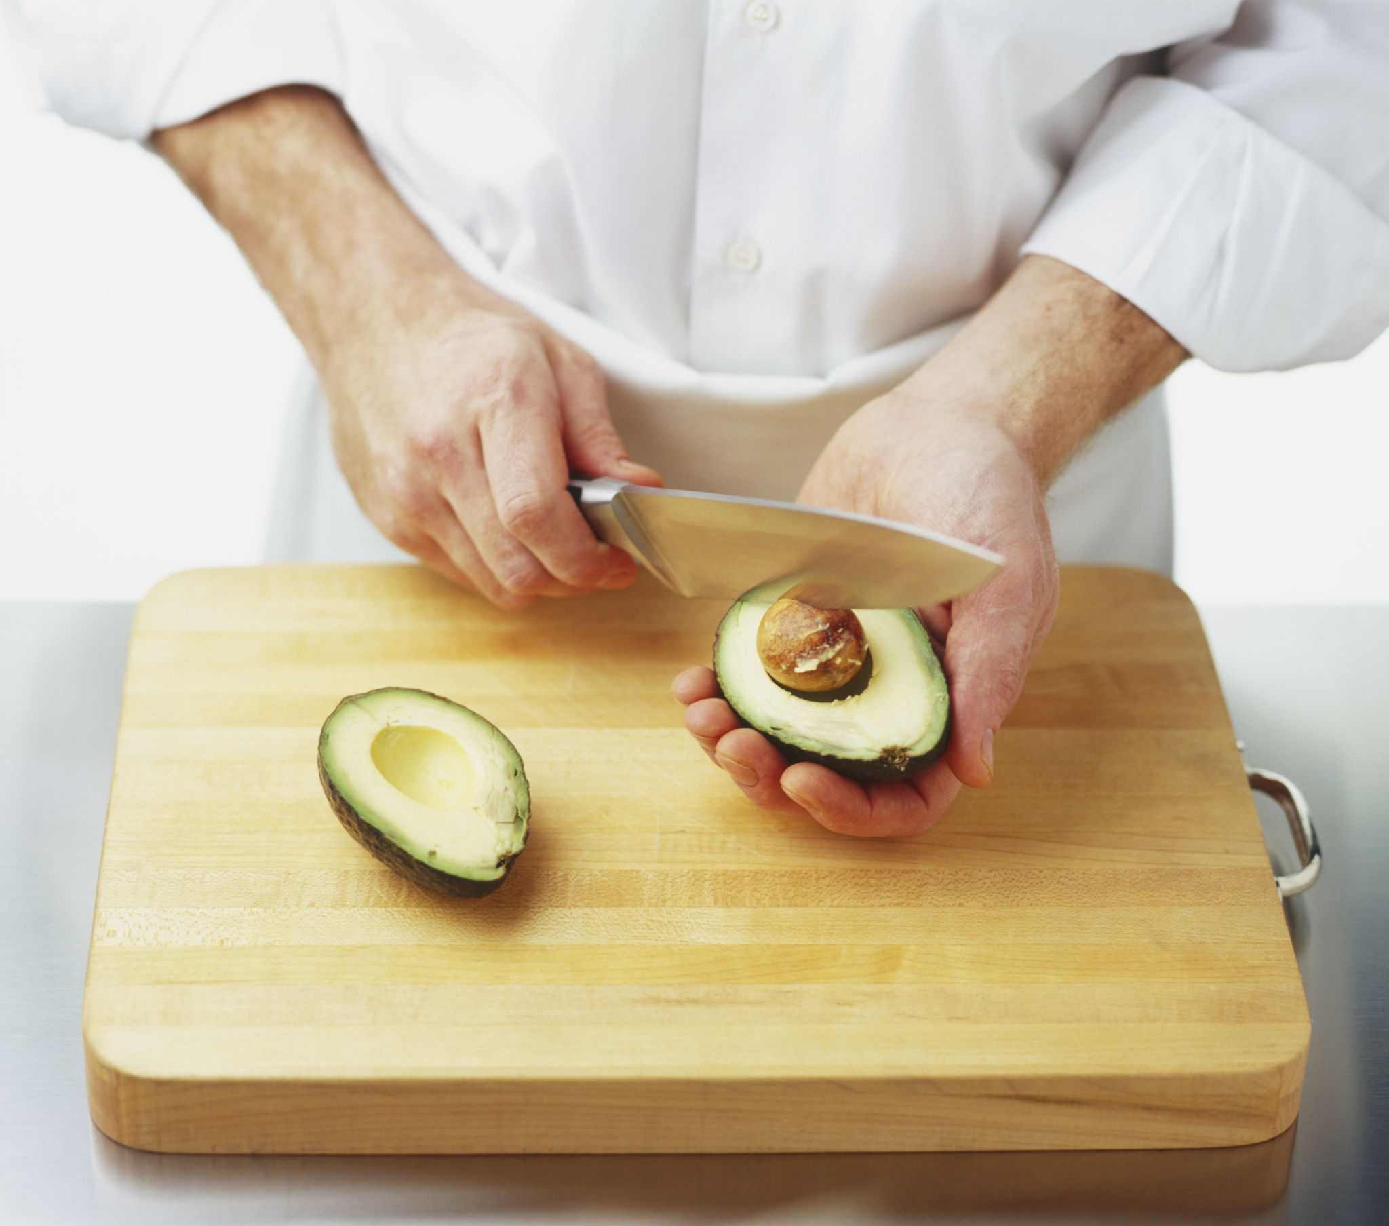
Motivation
Humans often interact with objects or objects with their hands. Hand gestures always appear in life.

Slide 5
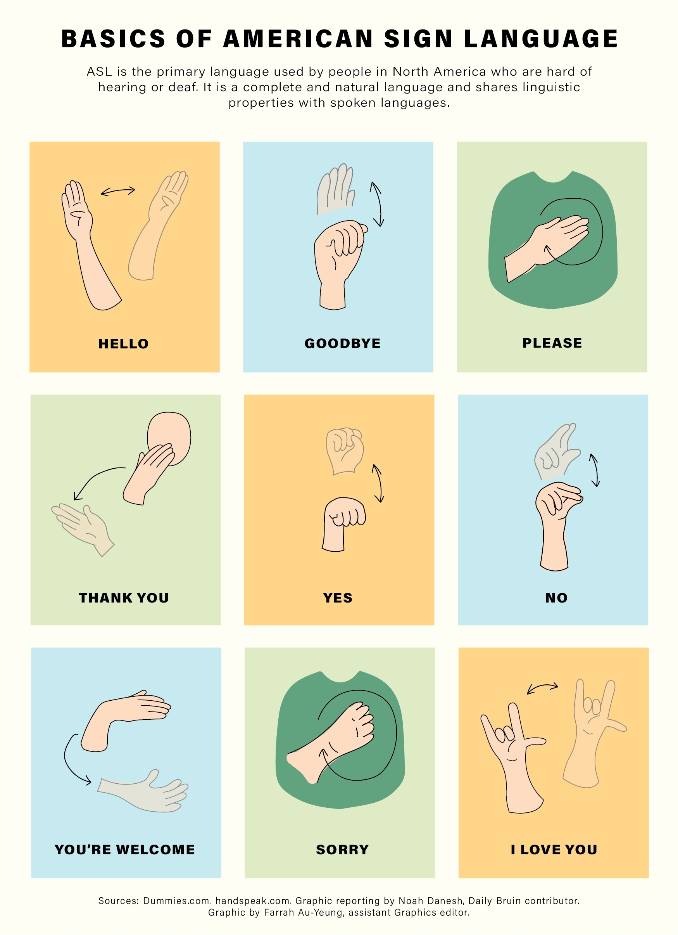

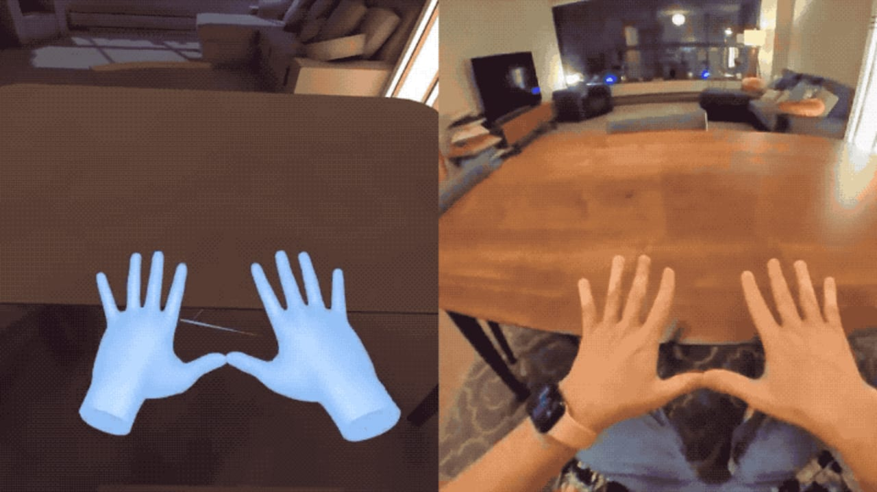
Motivation

Slide 6
PROBLEM STATEMENT

Slide 7
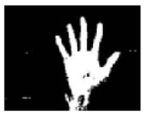
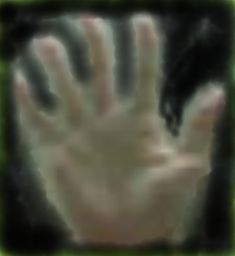
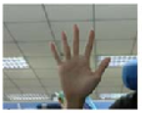
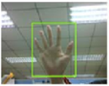
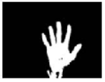
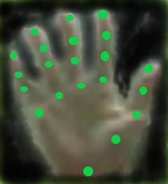
Problem Statement
The problem is to detect the hand, the anchor point on the hand from that result predicts the hand gesture.
Pre – processing
Skin Segmentation
Noise reduction
Input
A single RBG image
Hand region
Hand segmentation
Hand Key Points detection

Slide 8
RELATED WORK

Slide 9
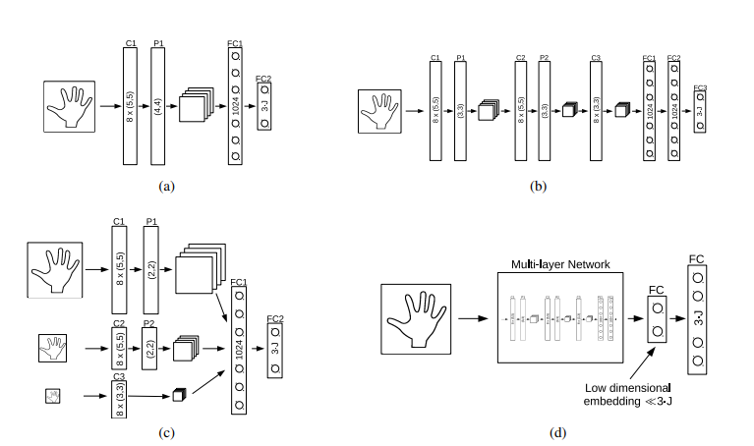
Hands Deep in Deep Learning for Hand Pose Estimation
Hand Detection

Slide 10
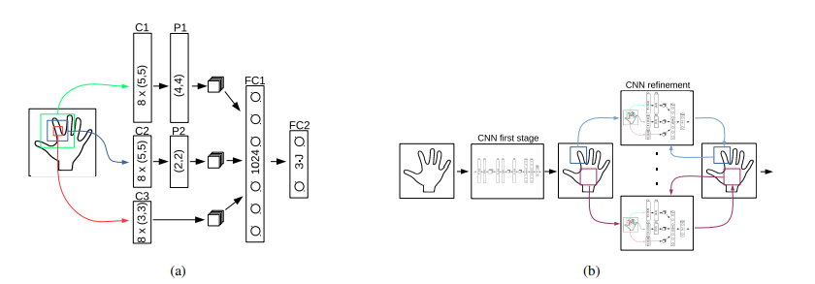
Hands Deep in Deep Learning for Hand Pose Estimation
Predict the position of the joints.

Slide 11
Hands Deep in Deep Learning for Hand Pose Estimation
Metric:
Euclide distance between the predicted result that fits the hand and the actual measurement result .
Pros:
The execution time is fast and the accuracy is high.
Cons:
Require labeled dataset and 3D locations for training.
When the pixel in the image is not available due to the brightness effect, the result will be inaccurate.

Slide 12
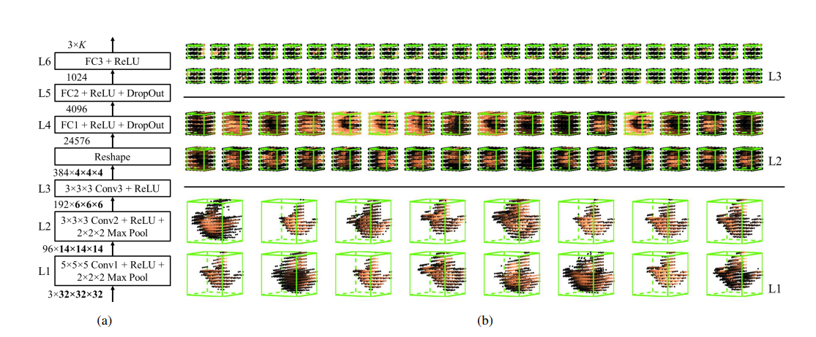
3D Convolutional Neural Networks for Efficient and Robust Hand Pose Estimation f-rom Single Depth Images

Slide 13
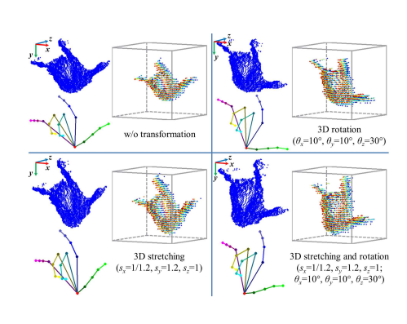
3D Convolutional Neural Networks for Efficient and Robust Hand Pose Estimation f-rom Single Depth Images

Slide 14
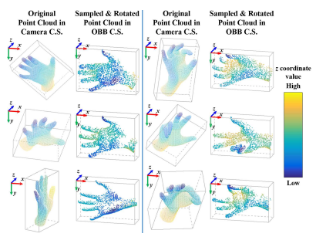
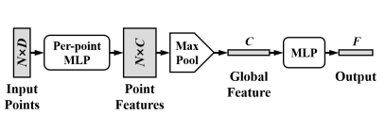
Hand PointNet: 3D Hand Pose Estimation using Point Sets

Slide 15
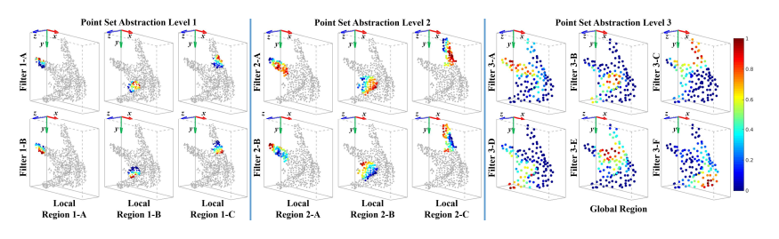
Hand PointNet: 3D Hand Pose Estimation using Point Sets

Slide 16
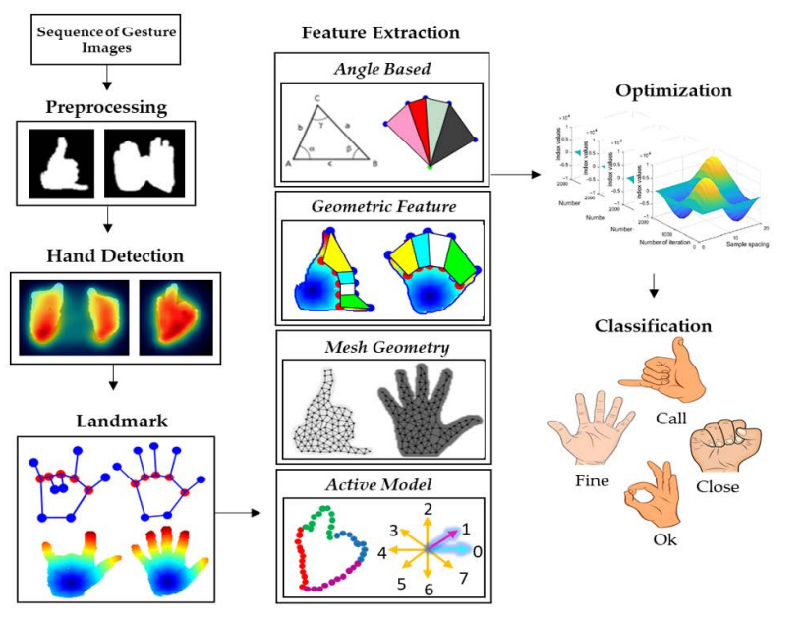
Hand Gesture Recognition Based on Auto-Landmark Localization and Reweighted Genetic Algorithm for Healthcare Muscle Activities

Slide 17
Paper | Year | Method | Metric | Pros | Cons
Hands Deep in Deep Learning for Hand Pose Estimation | 2016 | Using LRF to detect the hand. Using the CNN model to predict the position of the knuckles. | Euclidean distance between the predicted result of the knuckle and the actual measurement | The execution time is fast and the accuracy is high. | Require labeled dataset and 3D locations for training. When the pixel in the image is not available due to the brightness effect, the result will be inaccurate.

Slide 18
Paper | Year | Method | Metric | Pros | Cons
3D Convolut-ional Neural Networks for Efficient and Robust Hand Pose Estimation f-rom Single Depth Images | 2017 | Create cubes 3D hand representations from deep image​Using 3layer network architecture convolutional 3D connected.​ Enhance 3D data by rotating and stretching point clouds hands in 3D space. | Error Euclide Distance | Get quick results in real time.​ Applicable on multiple data variations with different hand sizes thanks to 3D data enhancement on the training dataset.​ | High computational complexity depends on the resolution.

Slide 19
Paper | Year | Method | Metric | Pros | Cons
Hand PointNet: 3D Hand Pose Estimation using Point Sets | 2018 | Extract distinguishing features using PointNet​ OBB-based point cloud normalization​ Construction of hand posture regression network Re-screen the fingertips. | Error Euclide Distance | Get quick results in real time.​ Applicable on multiple data variations with different hand sizes thanks to 3D data enhancement on the training dataset. | High computational complexity depends on the resolution.

Slide 20
Paper | Year | Method | Metric | Pros | Cons
The joint locations of the hand pose using deep networks | 2019 | Depth-based hand posture estimation through CNN neural network and Resnet50 model. | Measure on available data sets, containing hand frames, finger gestures to assess the accuracy of the method. ICVL Dataset ​ MSRA Dataset ​ NYU dataset | Avoid lost 3D spatial information in 2D heatmap Encode the point cloud in 3D representing the volume of the hand and use the 3D CNN for direct regression of the 3D hand posture | High computational complexity depends on resolution.

Slide 21
Paper | Year | Method | Metric | Pros | Cons
Fast Monocular Hand Pose Estimation on Embedded Systems | 2021 | MobileNet-SSD model hand detection​ Prediction of hand joint position using Hand Landmark Localization model | Sum squared error (SSE), endpoint error (EPE) and probability of correct score (PCK) within the normalized distance threshold​. | Avoid lost 3D spatial information in 2D heatmap Encode the point cloud in 3D representing the volume of the hand and use the 3D CNN for direct regression of the 3D hand posture | Requires good and stable equipment.

Slide 22
MEDIAPIPE APPROACH

Slide 23
CONTENT:
1. Introduction to Mediapipe
2. Datasets
3. Evaluation Metric
4. Architecture
4.1. Palm detection model
4.2. Hand landmark model

Slide 24
Dataset
Natural datasets
Internal datasets
Aggregate datasets
Dataset
Palm dectector
Hand landmark model
Hand presence

Slide 25
Dataset
Contains 6K images that vary in geography, lighting conditions, and hand appearance
Natural datasets
Does not contain complexities at the joints of the hand

Slide 26
Dataset
Contains 10 thousand images covering various angles of all possible hand gestures
Internal datasets
The data set was collected from only 30 people with limited changes in hand gestures

Slide 27
Dataset
Generate a high-quality composite hand model over various hand gestures and map it to the corresponding 3D coordinates
Using 3D hand model equipped with 24 bones and including 36 blend shapes, control the thickness of fingers and palm
Aggregate datasets
The model also offers 5 textures with different skin tones
Create video sequences that switch between hand poses and sample 100K images from the video

Slide 28
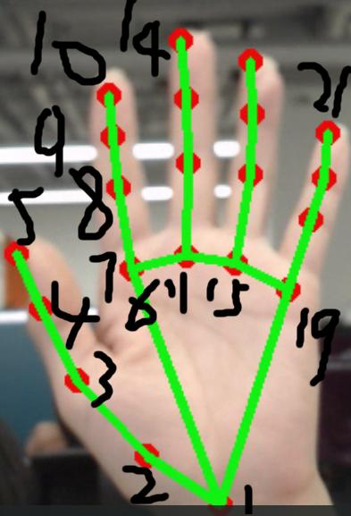
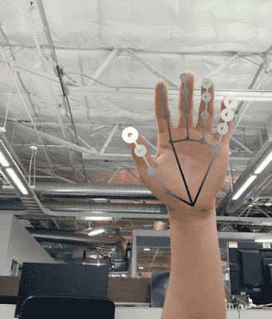
Dataset
Use only actual data sets
Palm Dectector
Localize the hand and provide the highest variety of forms

Slide 29
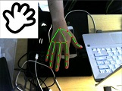
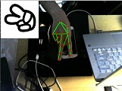
Dataset
Annotate real-world images with 21 landmarks
Hand Landmark Model
Use projected groundtruth 3D joints for composite images

Slide 30
Dataset
Choose a subset of real-world images as a positive example
Hand Presence
Samples on the area that do not include the hand area are annotated as negative examples
Đối với thuận tay, chúng tôi chú thích một tập hợp con của hình ảnh trong thế giới thực với sự thuận tay để cung cấp dữ liệu đó.

Slide 31
MediaPipe Hands
The combination of synthetic and natural (real-world) datasets gives the best results for the hand landmark model
Result
In addition to quality improvement, training with a large composite dataset results in less visual jitter across frames.

Slide 32
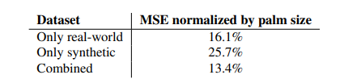
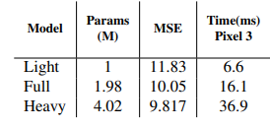
Result
evaluate only on pictures in the real world
performance trade-off between quality and speed

Slide 33
Architecture
Our hand tracking solution utilizes an ML pipeline consisting of two models working together:
• A palm detector that operates on a full input image and locates palms via an oriented hand bounding box.
• A hand landmark model that operates on the cropped hand bounding box provided by the palm detector and returns high-fidelity 2.5D landmarks.

Slide 34
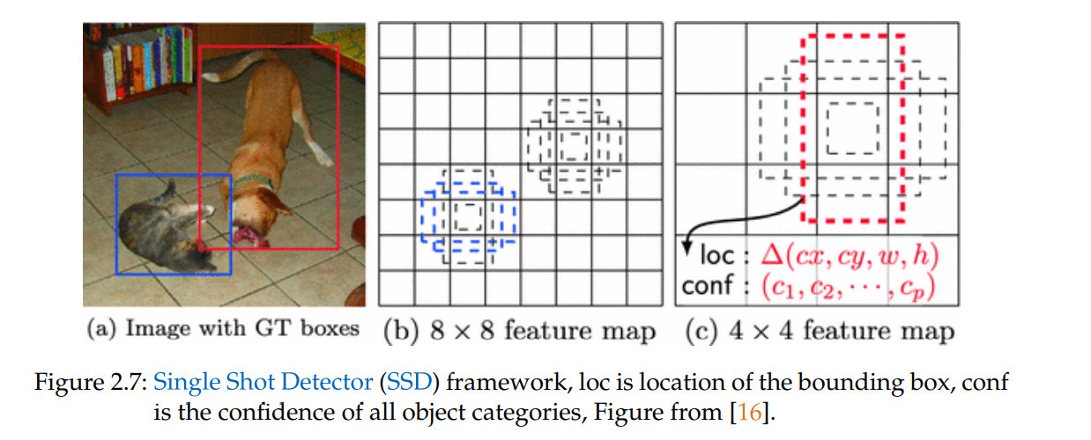
Palm Detection Model
Single Shot Detector (SSD)
SSD is a type of object detection algorithm that can be used for palm detection.
SSD only needs an input image and ground truth boxes for each object during training.

Slide 35
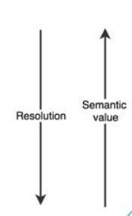
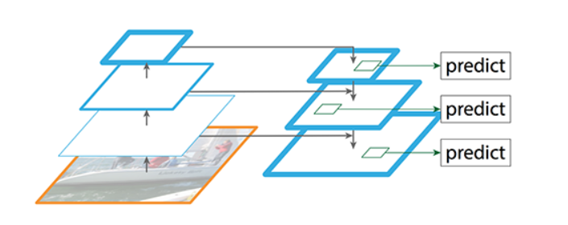
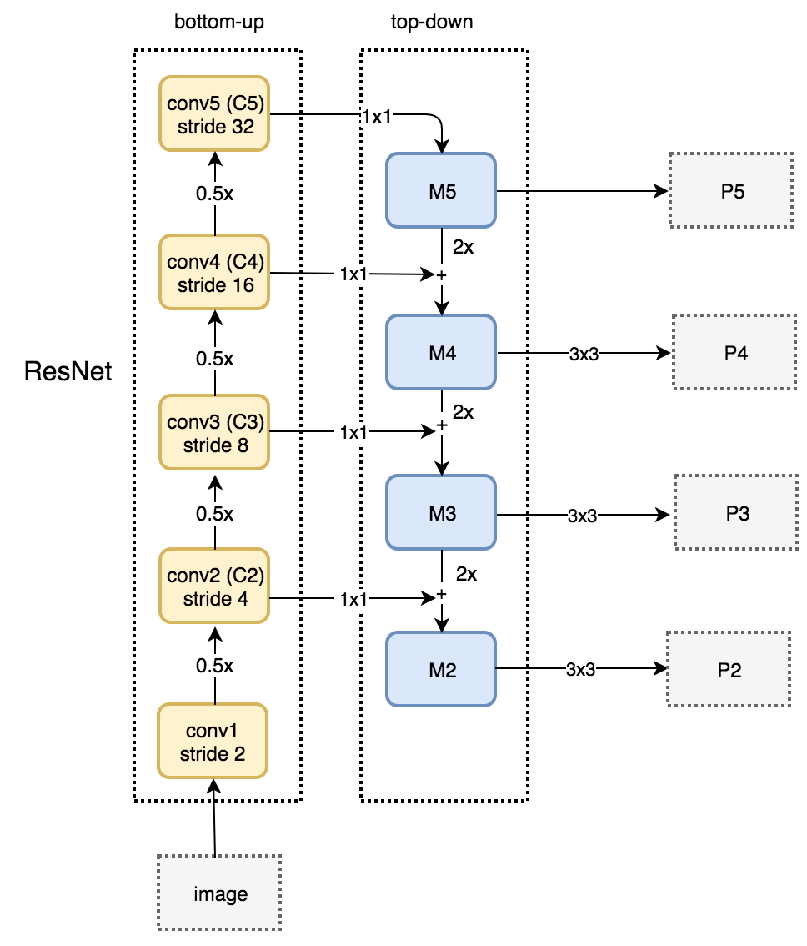
Palm Detection Model
Feature Pyramid Network (FPN)
FPN is a feature extractor designed for such pyramid concept with accuracy and speed in mind.
FPN composes of a bottom-up and a top-down pathway. The bottom-up pathway is the usual convolutional network for feature extraction. The top-down pathway to construct higher resolution layers from a semantic rich layer.

Slide 36
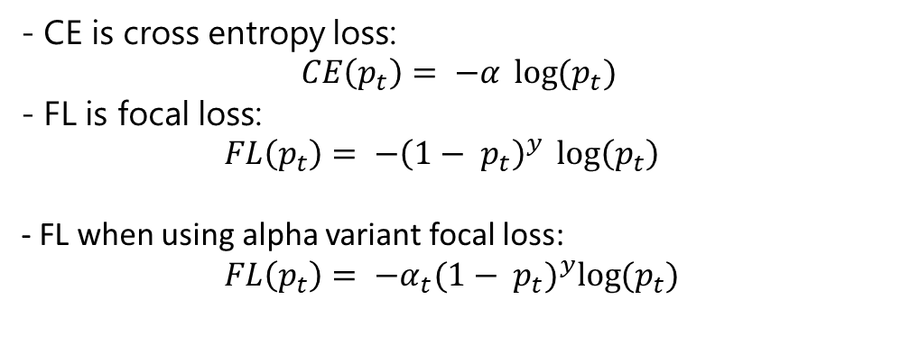
Palm Detection Model
Minimising focal loss
Focal loss addresses the problem of one stage detector where there is an imbalance between the foreground mage and the background image.
- CE is cross entropy loss:
$$CE\left(p_{t}\right)= −α \log{(p_{t})}$$
- FL is focal loss:
$FL\left(p_{t}\right)= −{\left(1− p_{t}\right)}^{y} \log\left(p_{t}\right)$
- FL when using alpha variant focal loss:
$FL\left(p_{t}\right)= −α_{t}{(1− p_{t})}^{y}\log{(p_{t})}$

Slide 37
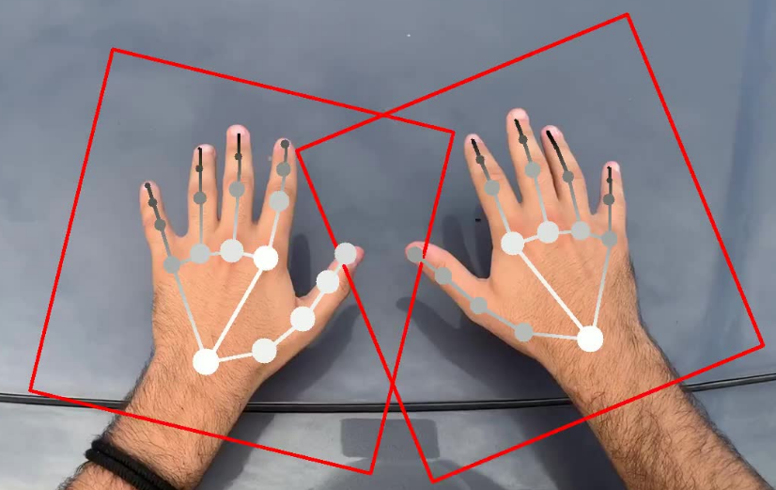
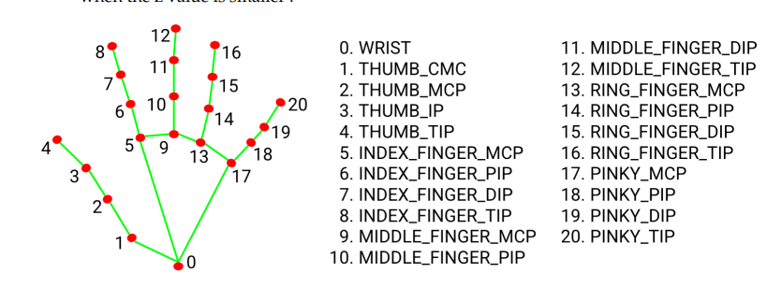
Hand land mark model
Input: The image contains the bounding box of the hand
Output:
The image contains 21 anchor points drawn on the hand
A hand flag indicating the probability of hand presence in the input image
A binary classification of handedness, e.g. left or right hand

Slide 38
Architecture of hand landmark model for MediaPipe
1. Multiview Bootstrapping
2. Recover tracking failure

Slide 39
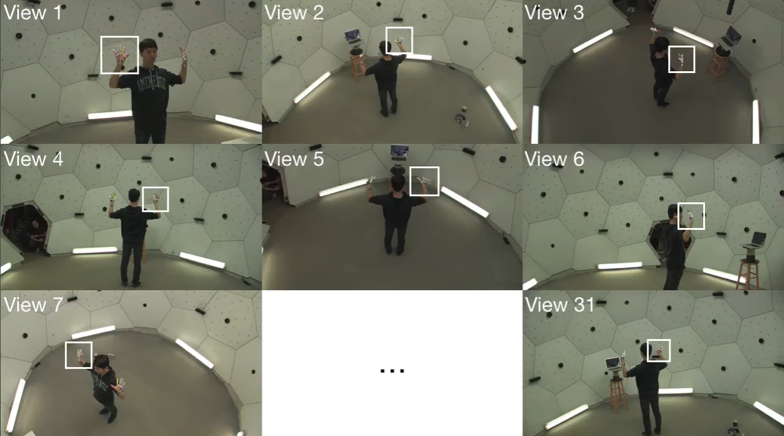
Idea behind multiview Bootstrapping

Slide 40
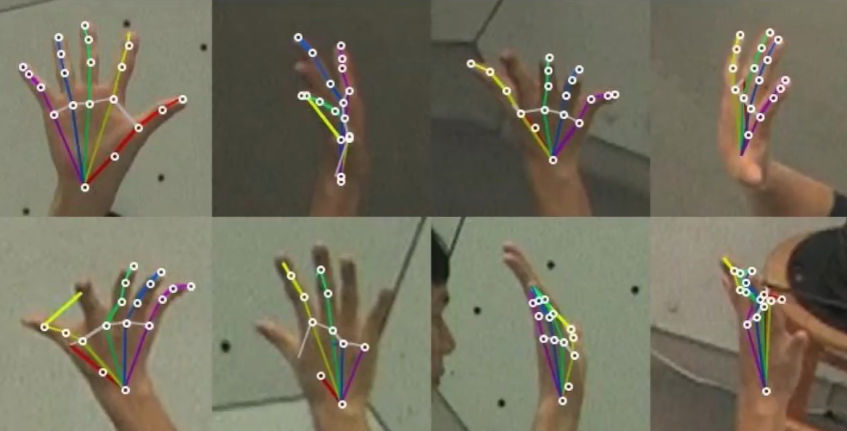
Idea behind multiview Bootstrapping ​

Slide 41
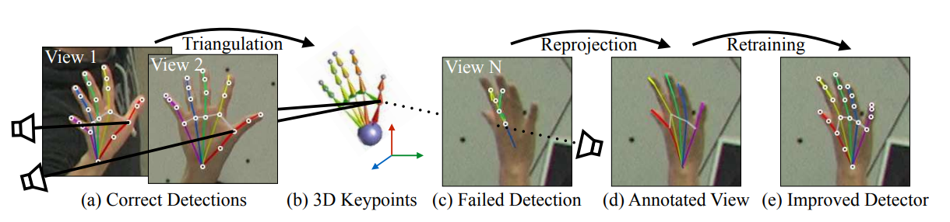
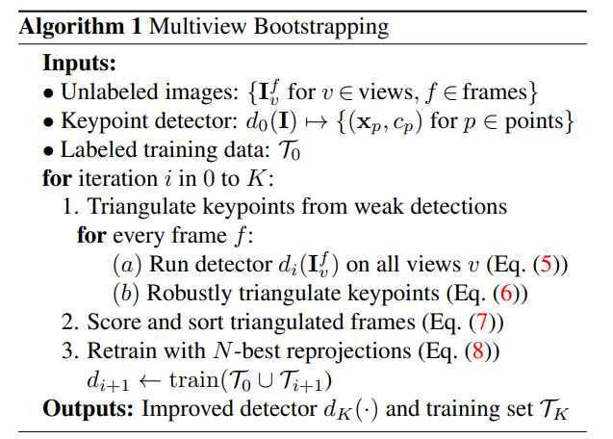
Multiview Bootstrapping algorithm

Slide 42
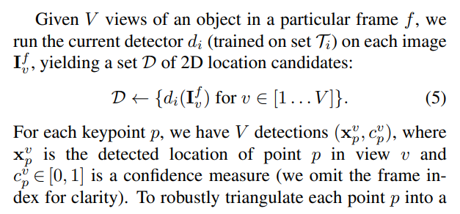
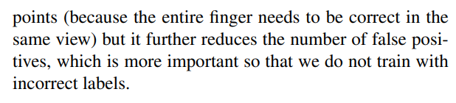
Triangulating Keypoints from Weak Detections
Notes:
(1) for every frame, the algorithm first runs the current detector on every camera view independently (Fig. 3a,c) and robustly triangulates the point detections (Fig. 3b);

Slide 43
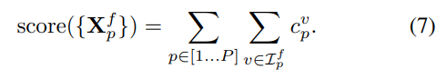
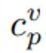
Scoring and Sorting Triangulated Frames
∈ [0, 1] is a confidence measure
Notes:
(2) the set of frames is then sorted according to a score to select only correctly triangulated examples

Slide 44
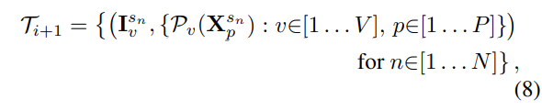
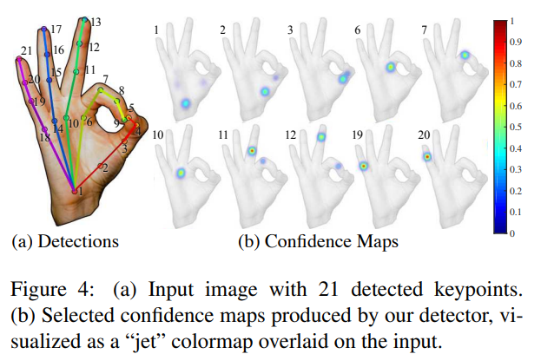
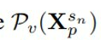
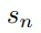
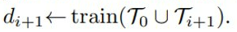
Retraining with N-best Reprojections
We use the N-best frames according to this order to define a new set of training image-keypoint pairs for the next iteration i+1 detector
: Projection of point p for frame index into view v. Finally, we train a new detector using the expanded training set as
Notes:
(3) the N-best frames are used to train a new detector by reprojecting the correctly triangulated points onto all views (Fig. 3d),

Slide 45
References
[1]https://arxiv.org/pdf/2006.10214v1.pdf
[2]Tomas Simon, Hanbyul Joo, Iain A. Matthews, and Yaser Sheikh. Hand keypoint detection in single images using multiview bootstrapping. CoRR, abs/1704.07809, 2017.
[3]https://www.youtube.com/watch?v=EgjwKM3KzGU&t=1690s
[4]https://github.com/nicknochnack/AdvancedHandPoseWithMediaPipe
[5]https://mediatum.ub.tum.de/doc/1658161/cyze4r5r5ptb06q0cb6rdi24h.pdf
[6]https://www.frontiersin.org/articles/10.3389/frai.2022.759255/full#B18
[7]https://openaccess.thecvf.com/content_ICCV_2019/papers/Chen_SO-HandNet_Self-Organizing_Network_for_3D_Hand_Pose_Estimation_With_Semi-Supervised_ICCV_2019_paper.pdf
[8]https://docs.google.com/viewer?a=v&pid=sites&srcid=ZGVmYXVsdGRvbWFpbnxnZWxpdWhhb250dXxneDoxMGU4YzMyMzNhMzM2NDUz
[9] Hand Keypint Detection in Single Images using Multiview Bootstrapping - YouTube

Slide 46
Thanks for watching and listening

